Slide 1
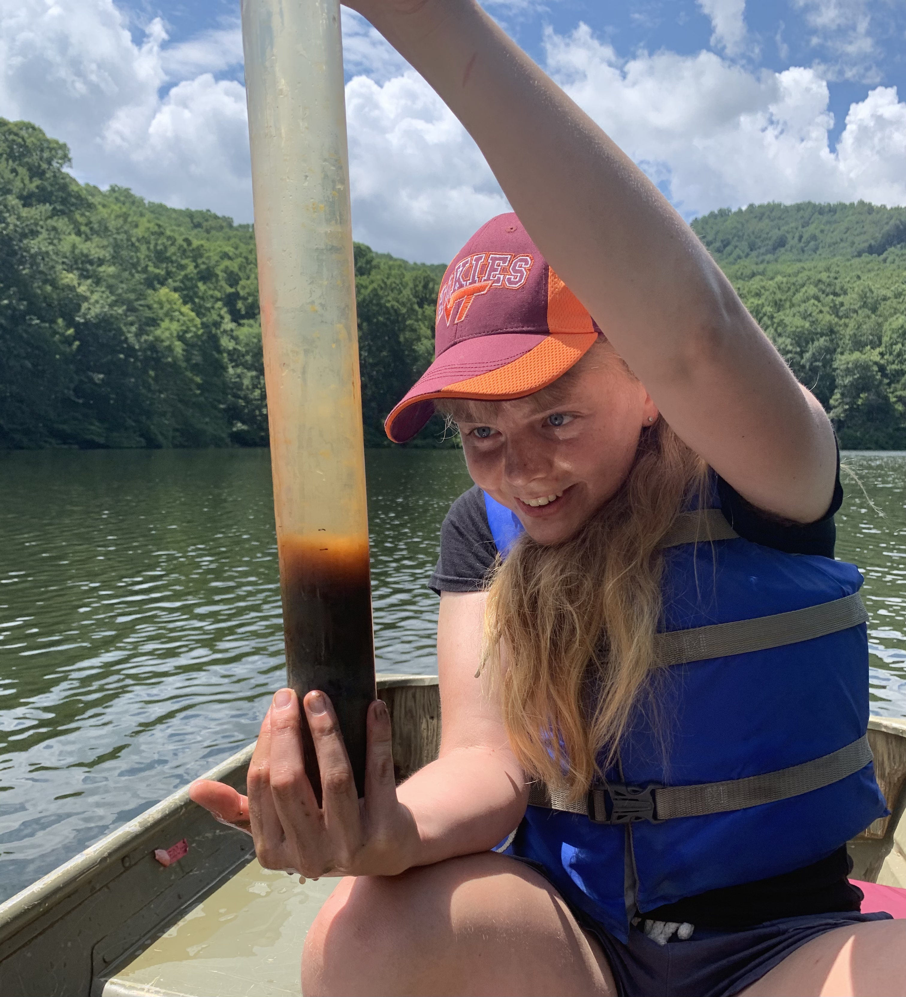


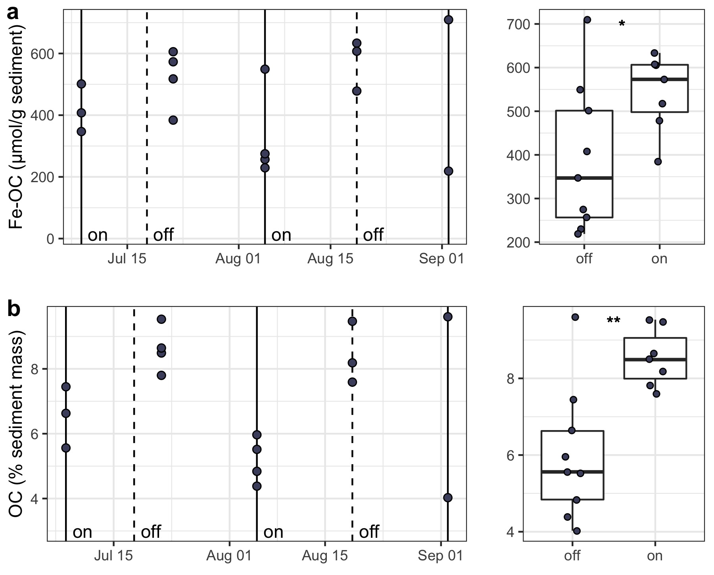
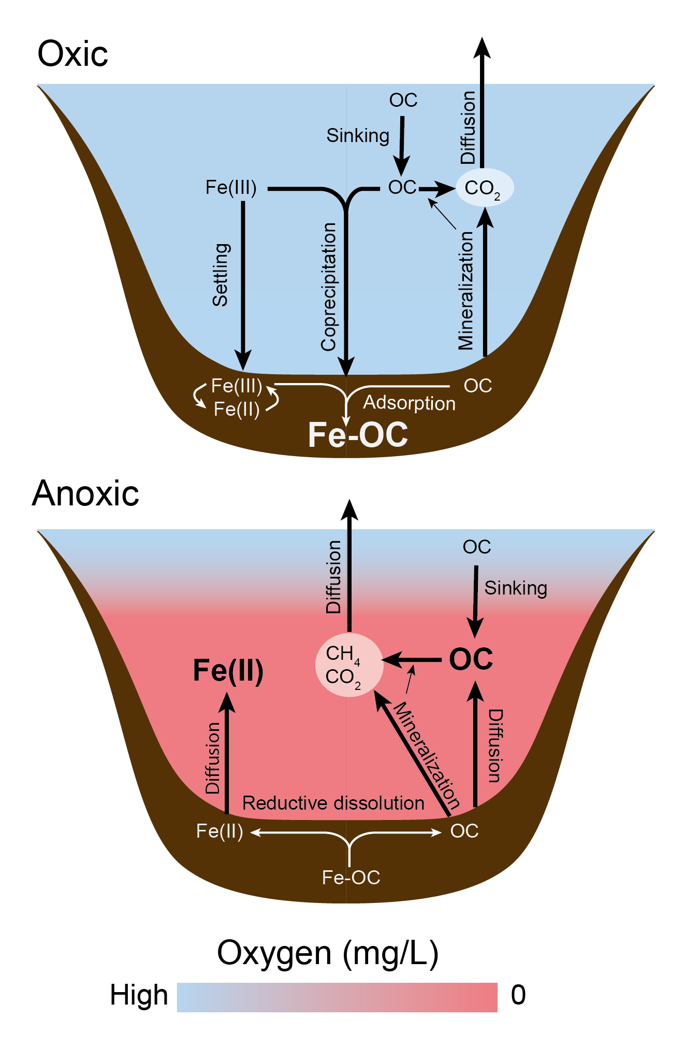
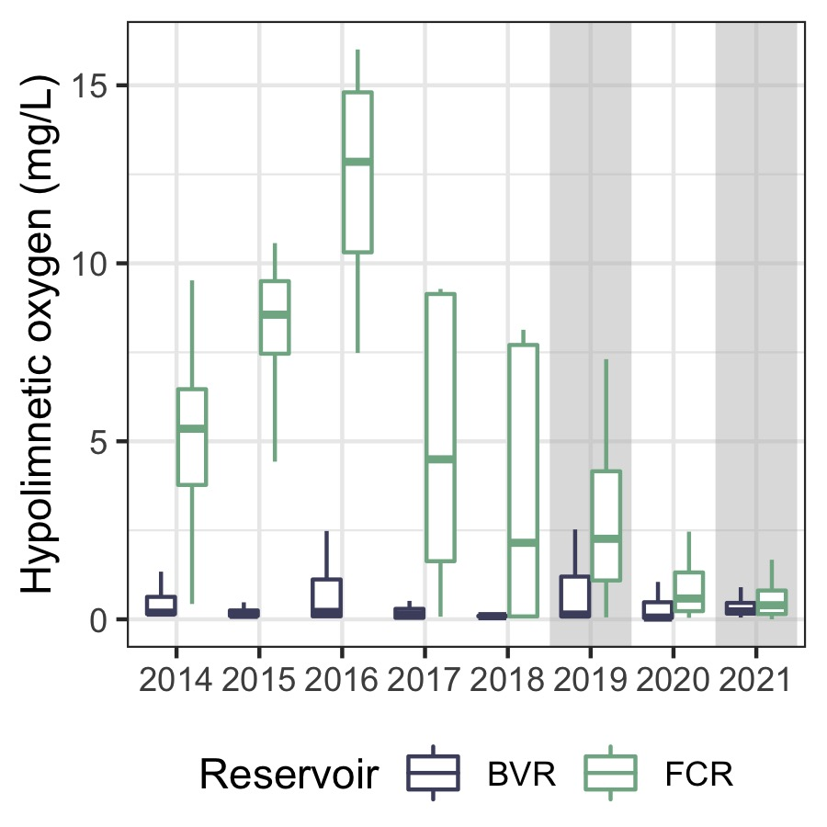
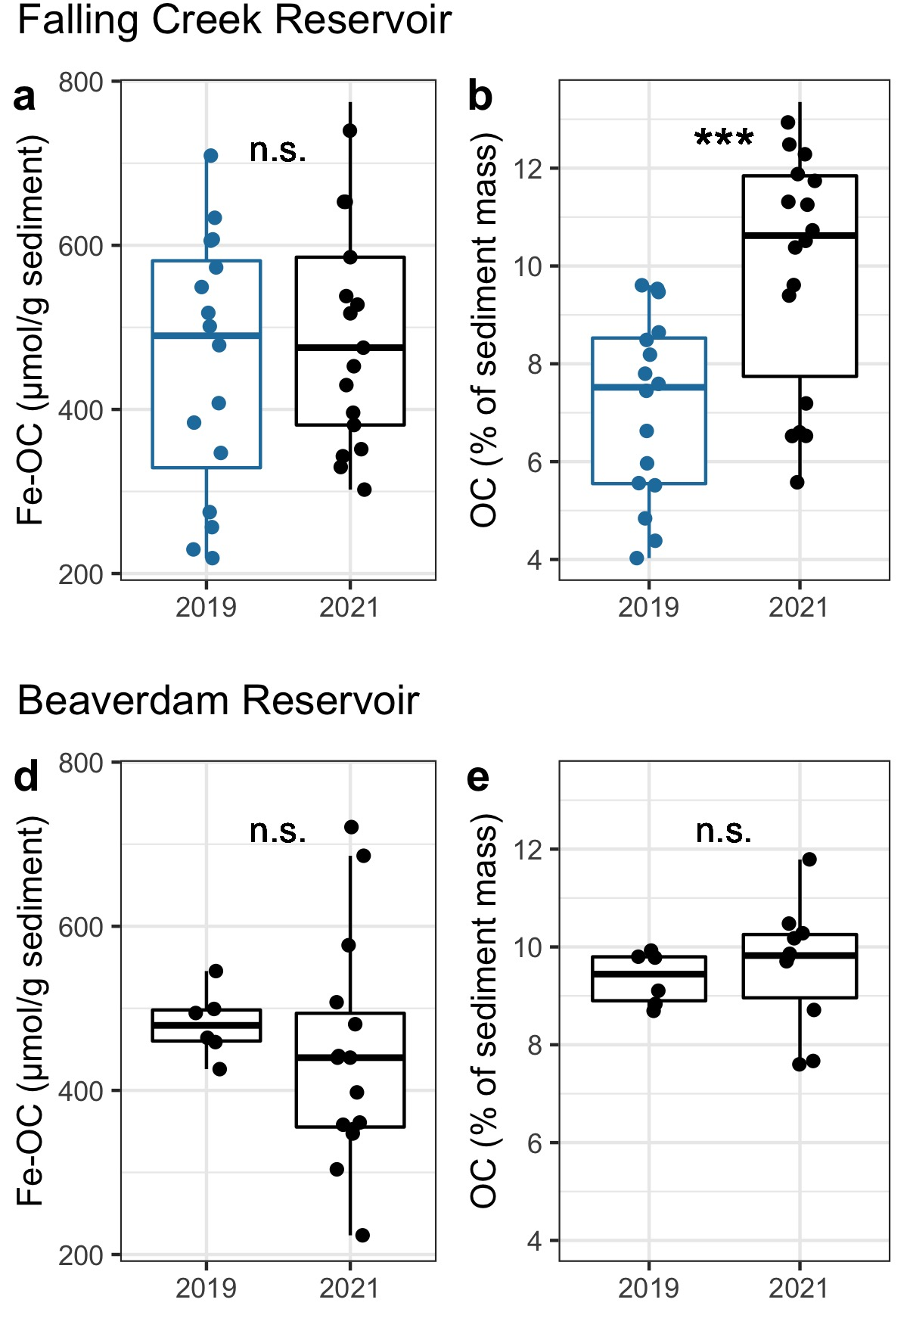
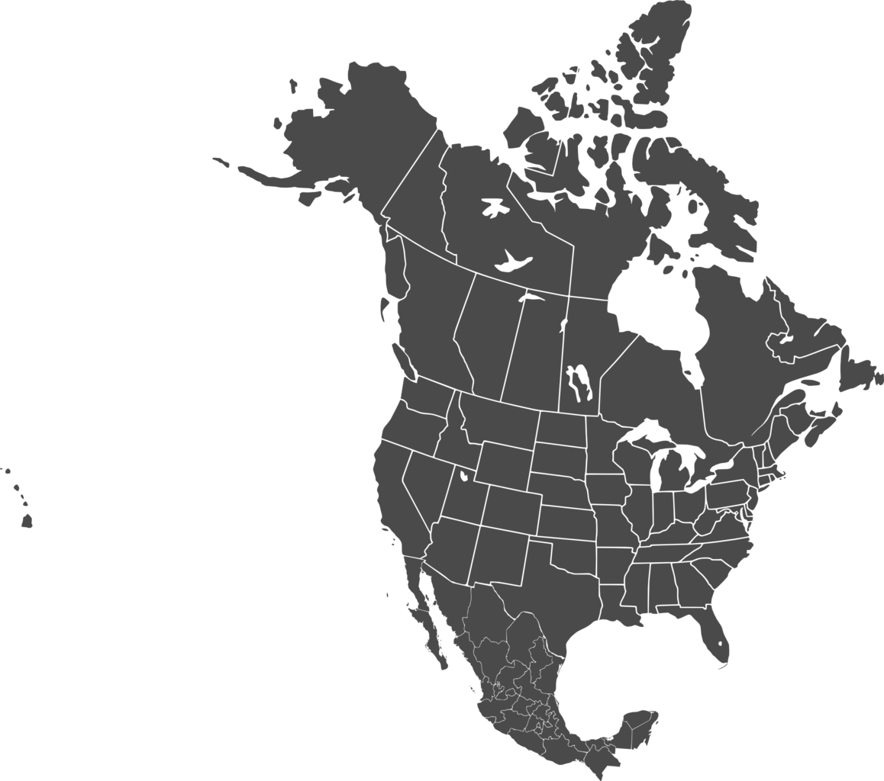
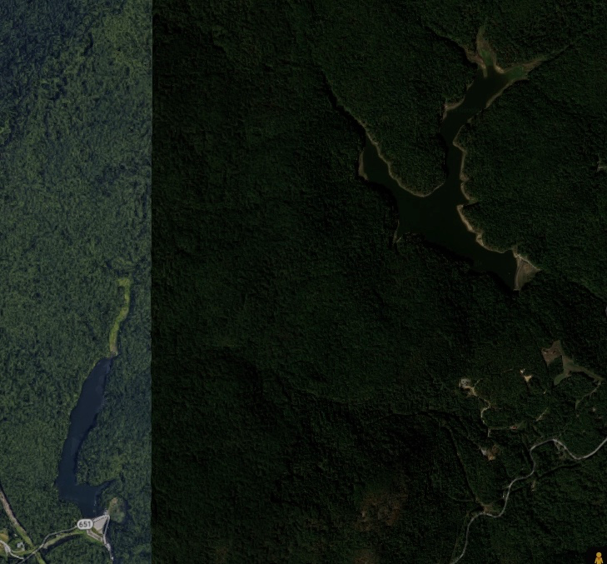
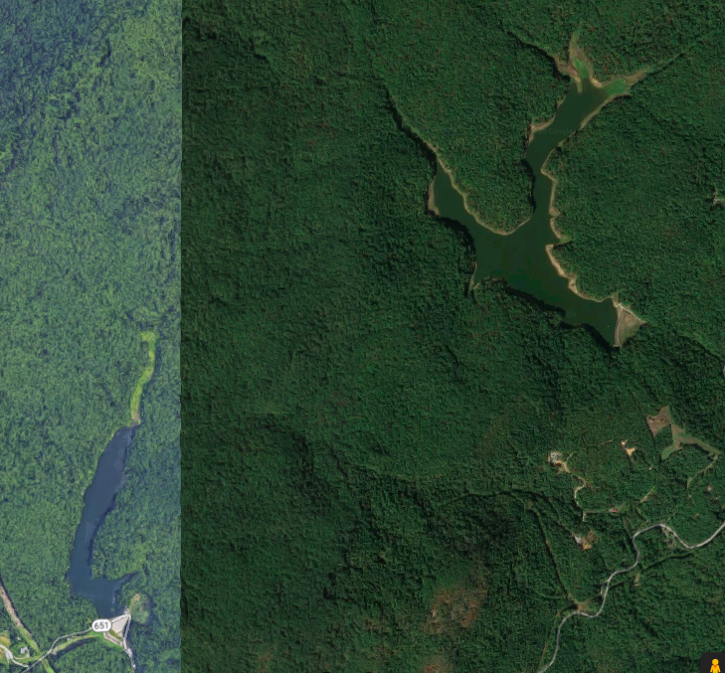

Effects of hypoxia on coupled iron and carbon cycling differ by timescale in two freshwater reservoirs
Abigail S. L. Lewis¹, B. R. Niederlehner¹, Arpita Das¹, Nicholas W. Hammond², Madeline E. Schreiber², Cayelan C. Carey¹
¹Department of Biological Sciences, Virginia Tech, Blacksburg, VA, USA
²Department of Geosciences, Virginia Tech, Blacksburg, VA, USA
aslewis@vt.edu
@lewis_lakes
ACKNOWLEDGEMENTS: Many thanks to the Carey Lab (past and present) and the Western Virginia Water Authority for enabling this research. This work is supported by NSF DEB-1753639 and by the Institute for Critical Technology and Applied Science at Virginia Tech.
Put boxes for titles in on a whim after printing this poster. Maybe they are terrible, haven’t decided. Also haven’t formatted them!!
MOTIVATION AND APPLICATION: Understand how oxygen concentrations may alter freshwater carbon cycling in the face of global change.
TWO-WEEK INTERVALS OF HYPOXIA DECREASE TOTAL ORGANIC CARBON AND IRON-BOUND ORGANIC CARBON IN SEDIMENT
We oxygenated Falling Creek Reservoir for intermittent 2-week intervals in 2019
Total organic carbon and iron-bound organic carbon were both lower following periods without oxygenation (Figure 2), likely due to redox-sensitivity of iron-bound organic carbon among other processes (Figure 1)
BACKGROUND
Organic materials (plants, animals, etc.) have two primary fates: they can either be buried in soils and sediment or emitted to the atmosphere as greenhouse gases
One of the main factors that helps to trap carbon in soils and sediment is chemical bonding with minerals (e.g., iron)¹
However, these associations may be sensitive to oxygen—low oxygen concentrations may release carbon for decomposition (Figure 1)^{2,3}
Better quantifying iron and carbon dynamics under varying oxygen conditions would help predict carbon cycling in the face of global change
OVER MULTIANNUAL TIMESCALES, HYPOXIA INCREASES TOTAL ORGANIC CARBON IN SEDIMENT WITHOUT CHANGING IRON-BOUND ORGANIC CARBON LEVELS
Figure 2: Changes in iron-bound organic carbon (a) and total organic carbon (b) in sediment as a result of oxygenation experiments. Solid lines and dashed lines indicate activation and inactivation of the oxygenation system, respectively. Left: time series data. Right: boxplots summarizing data based upon oxygenation status during the preceding two weeks. Statistical significance of differences between periods following oxygen (“on”) or no oxygenation (“off”) is indicated using asterisks: * indicates p < 0.05, ** indicates p < 0.01.
Oxygen decreased from 2019–2021 in FCR (Figure 3), resulting in increased sediment organic carbon but no change to iron-bound organic carbon (Figure 4)
Figure 1: Conceptual diagram describing the hypothesized effect of changing oxygen conditions on coupled Fe-OC interactions.
WHOLE-ECOSYSTEM OXYGENATION EXPERIMENTS HIGHLIGHT THE IMPACT OF OXYGEN ON IRON AND ORGANIC CARBON CYCLING
No comparable effects were seen in the unoxygenated reference reservoir (BVR)
Changing carbon mineralization rates may play a greater role in sediment carbon burial under varying oxygen concentrations than redox sensitivity of iron-bound organic carbon
Reservoirs are important sites for carbon processing, burying more carbon than oceans each year. Here, we used whole-ecosystem experiments to test the sensitivity of Fe-OC to changing oxygen levels in two reservoirs:
Falling Creek Reservoir (FCR)
Bottom-water oxygenation system has been operated since 2013, maintaining oxic conditions
Beaverdam Reservoir (BVR)
Reference reservoir
Beaverdam
Reservoir
Figure 3 (above): Bottom-water oxygen concentrations during the summer stratified periods (June–October) of 2014–2021 in Falling Creek Reservoir (FCR) and Beaverdam Reservoir (BVR). Gray shading highlights the focal years for this study (2019 and 2021).
Figure 4 (right): Differences in sediment organic carbon metrics between 2019 and 2021 in Falling Creek (a, b) and Beaverdam (d, e) Reservoirs.
Falling Creek Reservoir
1 km
REFERENCES
¹ Lalonde, K., A. Mucci, A. Ouellet, and Y. Gélinas. 2012. Preservation of organic matter in sediments promoted by iron. Nature 483: 198–200. ² Peter, S., O. Agstam, and S. Sobek. 2017. Widespread release of dissolved organic carbon from anoxic boreal lake sediments. Inland Waters 7: 151–163. ³ Peter, S., and S. Sobek. 2018. High variability in iron-bound organic carbon among five boreal lake sediments. Biogeochemistry 139: 19–29.

